Slide 1


The PiXL Club The PiXL Club The PiXL Club The PiXL Club The PiXL Club The PiXL Club The PiXL Club The PiXL Club The PiXL Club The PiXL Club The PiXL Club The PiXL Club The PiXL Club The PiXL Club The PiXL Club The PiXL Club The PiXL Club The PiXL Club The PiXL Club The PiXL Club The PiXL Club The PiXL Club The PiXL Club The PiXL Club The PiXL Club The PiXL Club The PiXL Club The PiXL Club The PiXL Club The PiXL Club The PiXL Club The PiXL Club The PiXL Club The PiXL Club The PiXL Club The PiXL Club The PiXL Club The PiXL Club The PiXL Club The PiXL Club The PiXL Club The PiXL Club The PiXL Club The PiXL Club The PiXL Club XL Club The PiXL Club The PiXL Club The PiXL Club The PiXL Club The PiXL Club The PiXL Club The PiXL Club The PiXL Club The PiXL Club The PiXL Club The PiXL Club The PiXL Club The PiXL Club The PiXL Club The PiXL Club The PiXL Club The PiXL Club The PiXL Club The PiXL Club The PiXL Club The PiXL Club The PiXL Club The PiXL Club The PiXL Club The PiXL Club The PiXL Club The PiXL Club The PiXL Club The PiXL Club The PiXL Club The PiXL Club The PiXL Club The PiXL Club The PiXL Club The PiXL Club The PiXL Club The PiXL Club The PiXL Club The PiXL Club The PiXL Club The PiXL Club The PiXL Club The PiXL Club The PiXL Club The PiXL Club The PiXL Club The PiXL Club The PiXL Club The PiXL Club The PiXL Club The PiXL Club The PiXL Club The PiXL Club The PiXL Club The PiXL Club The PiXL Club The PiXL Club The PiXL Club The PiXL Club The PiXL Club The PiXL Club The PiXL Club The PiXL Club The PiXL Club The PiXL Club The PiXL Club The PiXL Club The PiXL Club The PiXL Club The PiXL Club The PiXL Club The PiXL Club The PiXL Club The PiXL Club The PiXL Club The PiXL Club The PiXL Club The PiXL Club The PiXL Club The PiXL Club The PiXL Club The PiXL Club The PiXL Club The PiXL Club The PiXL Club The PiXL Club The PiXL Club The PiXL Club The PiXL Club The PiXL Club The PiXL Club The PiXL Club The PiXL Club The PiXL Club The PiXL Club The PiXL Club The PiXL Club The PiXL Club The PiXL Club The PiXL Club The PiXL Club The PiXL Club The PiXL Club The PiXL Club The PiXL Club The PiXL Club The PiXL Club The PiXL Club The PiXL Club The PiXL Club The PiXL Club The PiXL Club The PiXL Club The PiXL Club The PiXL Club The PiXL Club The PiXL Club The PiXL Club The PiXL Club The PiXL Club The PiXL Club The PiXL Club The PiXL Club The PiXL Club The PiXL Club The PiXL Club The PiXL Club The PiXL Club The PiXL Club The PiXL Club The PiXL Club The PiXL Club The PiXL Club The PiXL Club The PiXL Club The PiXL Club The PiXL Club The PiXL Club The PiXL Club The PiXL Club The PiXL Club The PiXL Club The PiXL Club The PiXL Club The PiXL Club The PiXL Club The PiXL Club The PiXL Club The PiXL Club The PiXL Club The PiXL Club The PiXL Club The PiXL Club The PiXL Club The PiXL Club The PiXL Club The PiXL Club The PiXL Club The PiXL Club The PiXL Club The PiXL Club The PiXL Club The PiXL Club The PiXL Club The PiXL Club The PiXL Club The PiXL Club The PiXL Club The PiXL Club The PiXL Club The PiXL Club The PiXL Club The PiXL Club The PiXL Club The PiXL Club The PiXL Club The PiXL Club The PiXL Club The PiXL Club The PiXL Club The PiXL Club The PiXL Club The PiXL Club The PiXL Club The PiXL Club The PiXL Club The PiXL Club The PiXL Club The PiXL Club The PiXL Club The PiXL Club The PiXL Club The PiXL Club The PiXL Club The PiXL Club The PiXL Club The PiXL Club The PiXL Club The PiXL Club The PiXL Club The PiXL Club The PiXL Club The PiXL Club The PiXL Club The PiXL Club The PiXL Club The PiXL Club The PiXL Club The PiXL Club The PiXL Club The PiXL Club The PiXL Club The PiXL Club The PiXL Club The PiXL Club The PiXL Club The PiXL Club The PiXL Club The PiXL Club The PiXL Club The PiXL Club The PiXL Club The PiXL Club The PiXL Club The PiXL Club The PiXL Club The PiXL Club The PiXL Club The PiXL Club The PiXL Club The PiXL Club The PiXL Club The PiXL Club The PiXL Club The PiXL Club The PiXL Club The PiXL Club The PiXL Club The PiXL Club The PiXL Club The PiXL Club The PiXL Club The PiXL Club The PiXL Club The PiXL Club The PiXL Club The PiXL Club The PiXL Club The PiXL Club The PiXL Club The PiXL Club The PiXL Club The PiXL Club The PiXL Club The PiXL Club The PiXL Club The PiXL Club The PiXL Club The PiXL Club The PiXL Club The PiXL Club The PiXL Club The PiXL Club The PiXL Club The PiXL Club The PiXL Club The PiXL Club The PiXL Club The PiXL Club The PiXL Club The PiXL Club The PiXL Club The PiXL Club The PiXL Club The PiXL Club The PiXL Club The PiXL Club The PiXL Club The PiXL Club The PiXL Club The PiXL Club The PiXL Club The PiXL Club The PiXL Club The PiXL Club The PiXL Club The PiXL Club The PiXL Club The PiXL Club The PiXL Club The PiXL Club The PiXL Club The PiXL Club The PiXL Club The PiXL Club The PiXL Club The PiXL Club The PiXL Club The PiXL Club The PiXL Club The PiXL Club The PiXL Club The PiXL Club The PiXL Club The PiXL Club The PiXL Club The PiXL Club The PiXL Club The PiXL Club The PiXL Club The PiXL Club The PiXL Club The PiXL Club The PiXL Club The PiXL Club The PiXL Club The PiXL Club The PiXL Club The PiXL Club The PiXL Club The PiXL Club The PiXL Club The PiXL Club The PiXL Club The PiXL Club The PiXL Club The PiXL Club The PiXL Club The PiXL Club The PiXL Club The PiXL Club The PiXL Club The PiXL Club The PiXL Club The PiXL Club The PiXL Club The PiXL Club The PiXL Club The PiXL Club The PiXL Club The PiXL Club The PiXL Club The PiXL Club The PiXL Club The PiXL Club The PiXL Club The PiXL Club The PiXL Club The PiXL Club The PiXL Club The PiXL Club The PiXL Club The PiXL Club The PiXL Club The PiXL Club The PiXL Club The PiXL Club The PiXL Club The PiXL Club The PiXL Club The PiXL Club The PiXL Club The PiXL Club The PiXL Club The PiXL Club The PiXL Club The PiXL Club The PiXL Club The PiXL Club The PiXL Club The PiXL Club The PiXL Club The PiXL Club The PiXL Club The PiXL Club The PiXL Club The PiXL Club The PiXL Club The PiXL Club The PiXL Club The PiXL Club The PiXL Club The PiXL Club The PiXL Club The PiXL Club The PiXL Club The PiXL Club The PiXL Club The PiXL Club The PiXL Club The PiXL Club The PiXL Club The PiXL Club The PiXL Club The PiXL Club The PiXL Club The PiXL Club The PiXL Club The PiXL Club The PiXL Club The PiXL Club The PiXL Club The PiXL Club The PiXL Club The PiXL Club The PiXL Club The PiXL Club The PiXL Club The PiXL Club The PiXL Club The PiXL Club The PiXL Club The PiXL Club The PiXL Club The PiXL Club The PiXL Club The PiXL Club The PiXL Club The PiXL Club The PiXL Club The PiXL Club The PiXL Club The PiXL Club The PiXL Club The PiXL Club The PiXL Club The PiXL Club The PiXL Club The PiXL Club The PiXL Club The PiXL Club The PiXL Club The PiXL Club The PiXL Club The PiXL Club The PiXL Club The PiXL Club The PiXL Club The PiXL Club The PiXL Club The PiXL Club The PiXL Club The PiXL Club The PiXL Club The PiXL Club The PiXL Club The PiXL Club The PiXL Club The PiXL Club The PiXL Club The PiXL Club The PiXL Club The PiXL Club The PiXL Club The PiXL Club The PiXL Club The PiXL Club The PiXL Club The PiXL Club The PiXL Club The PiXL Club The PiXL Club The PiXL Club The PiXL Club The PiXL Club The PiXL Club The PiXL Club The PiXL Club The PiXL Club The PiXL Club The PiXL Club The PiXL Club The PiXL Club The PiXL Club The PiXL Club The PiXL Club The PiXL Club The PiXL Club The PiXL Club The PiXL Club The PiXL Club The PiXL Club The PiXL Club The PiXL Club The PiXL Club The PiXL Club The PiXL Club The PiXL Club The PiXL Club The PiXL Club The PiXL Club The PiXL Club The PiXL Club The PiXL Club The PiXL Club The PiXL Club The PiXL Club The PiXL Club The PiXL Club The PiXL Club The PiXL Club The PiXL Club The PiXL Club The PiXL Club The PiXL Club The PiXL Club The PiXL Club The PiXL Club The PiXL Club The PiXL Club The PiXL Club The PiXL Club The PiXL Club The PiXL Club The PiXL Club The PiXL Club The PiXL Club The PiXL Club The PiXL Club The PiXL Club The PiXL Club The PiXL Club The PiXL Club The PiXL Club The PiXL Club The PiXL Club The PiXL Club The PiXL Club The PiXL Club The PiXL Club The PiXL Club The PiXL Club The PiXL Club The PiXL Club The PiXL Club The PiXL Club The PiXL Club The PiXL Club The PiXL Club The PiXL Club The PiXL Club The PiXL Club The PiXL Club The PiXL Club The PiXL Club The PiXL Club The PiXL Club The PiXL Club The PiXL Club The PiXL Club The PiXL Club The PiXL Club The PiXL Club The PiXL Club The PiXL Club The PiXL Club The PiXL Club The PiXL Club The PiXL Club The PiXL Club The PiXL Club The PiXL Club The PiXL Club The PiXL Club The PiXL Club The PiXL Club The PiXL Club The PiXL Club The PiXL Club The PiXL Club The PiXL Club The PiXL Club The PiXL Club The PiXL Club The PiXL Club The PiXL Club The PiXL Club The PiXL Club The PiXL Club The PiXL Club The PiXL Club The PiXL Club The PiXL Club The PiXL Club The PiXL Club The PiXL Club The PiXL Club The PiXL Club The PiXL Club The PiXL Club The PiXL Club The PiXL Club The PiXL Club The PiXL Club The PiXL Club The PiXL Club The PiXL Club The PiXL Club The PiXL Club The PiXL Club The PiXL Club The PiXL Club The PiXL Club The PiXL Club The PiXL Club The PiXL Club The PiXL Club The PiXL Club The PiXL Club The PiXL Club The PiXL Club The PiXL Club The PiXL Club The PiXL Club The PiXL Club The PiXL Club The PiXL Club The PiXL Club The PiXL Club The PiXL Club The PiXL Club The PiXL Club The PiXL Club The PiXL Club The PiXL Club The PiXL Club The PiXL Club The PiXL Club The PiXL Club The PiXL Club The PiXL Club The PiXL Club The PiXL Club The PiXL Club The PiXL Club The PiXL Club The PiXL Club The PiXL Club The PiXL Club The PiXL Club The PiXL Club The PiXL Club The PiXL Club The PiXL Club The PiXL Club The PiXL Club The PiXL Club The PiXL Club The PiXL Club The PiXL Club The PiXL Club The PiXL Club The PiXL Club The PiXL Club The PiXL Club The PiXL Club The PiXL Club The PiXL Club The PiXL Club The PiXL Club The PiXL Club The PiXL Club The PiXL Club The PiXL Club The PiXL Club The PiXL Club The PiXL Club The PiXL Club The PiXL Club The PiXL Club The PiXL Club The PiXL Club The PiXL Club The PiXL Club The PiXL Club The PiXL Club The PiXL Club The PiXL Club The PiXL Club The PiXL Club The PiXL Club The PiXL Club The PiXL Club The PiXL Club The PiXL Club The PiXL Club The PiXL Club The PiXL Club The PiXL Club The PiXL Club The PiXL Club The PiXL Club The PiXL Club The PiXL Club The PiXL Club The PiXL Club The PiXL Club The PiXL Club The PiXL Club The PiXL Club
PiXL KnowIT!
GCSE Chemistry
Edexcel Topic – Groups in the periodic table
© Copyright The PiXL Club Ltd, 2017
This resource is strictly for the use of member schools for as long as they remain members of The PiXL Club. It may not be copied, sold nor transferred to a third party or used by the school after membership ceases. Until such time it may be freely used within the member school.
All opinions and contributions are those of the authors. The contents of this resource are not connected with nor endorsed by any other company, organisation or institution.
www.pixl.org.uk The PiXL Club Ltd, Company number 07321607

Slide 2
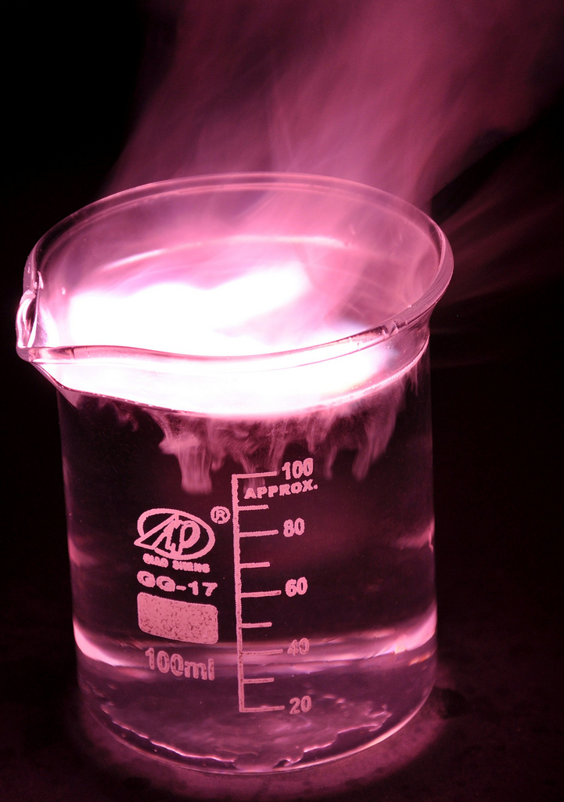
Overview Groups in the periodic table
Periodic table
Group 1
Group 7
Group 0
Notes:
https://c2.staticflickr.com/4/3178/4076380768_03994aed44_b.jpg

Slide 3

LearnIT!
KnowIT!
Periodic table
Group 1
Group 7
Group 0

Slide 4
Periodic table – Group 1
1
2
3
4
5
6
7
0
H
He
Li
Be
B
C
N
O
F
Ne
THE ALKALI METALS
Na
Mg
Al
Si
P
S
Cl
Ar
K
Ca
Sc
Ti
V
Cr
Mn
Fe
Co
Ni
Cu
Zn
Ga
Ge
As
Se
Br
Kr
Rb
Sr
Y
Zr
Nb
Mo
Tc
Ru
Rh
Pd
Ag
Cd
In
Sn
Sb
Te
I
Xe
Cs
Ba
La
Hf
Ta
W
Re
Os
Ir
Pt
Au
Hg
Tl
Pb
Bi
Po
At
Rn
Fr
Ra
Ac
Rf
Db
Sg
Bh
Hs
Mt
?
?
?
The alkali metals are very reactive. They need to be stored under oil to prevent them reacting with oxygen and water vapour in the air. The metals are very soft and can be cut with a knife. They also have low melting points.
The properties are due to all the atoms having just one electron in their outermost shell. They only need to lose one electron to get the stable electronic structure of a noble gas.
The atoms get larger as you go down, so the single electron in the outermost shell (highest energy level) is attracted less strongly to the positive nucleus. The electrostatic attraction with the nucleus gets weaker because the distance between the outer electron and the nucleus increases. Also the outer electron experiences a shielding effect from the inner electrons, reducing the attraction between the oppositely charged outer electron and the nucleus.
Li
Reactivity
Increases
Na
K
Rb
Cs

Slide 5
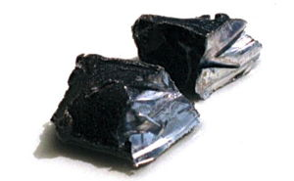
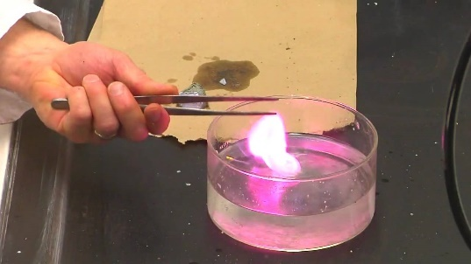
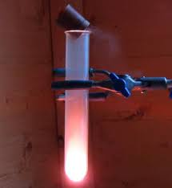
Periodic table – Group 1
The alkali metals have a silvery, shiny surface when they are first cut. However, this goes dull very quickly as the metals reacts with the oxygen in the air.
e.g. sodium + oxygen → sodium oxide
4Na(s) + O₂(g) → 2Na₂O(s)
Lithium, sodium and potassium all react vigorously with water. When you add them to water, the metal floats, moves around and fizzes.
e.g. potassium + water → potassium hydroxide + hydrogen
2K(s) + 2H₂O(l) → 2KOH(aq) + H₂(g)
Potassium ignites with a lilac flame
` They also react vigorously with non metals, such as Group 7. They form 1+ ions in the reactions to make ionic compounds. These are generally white and dissolve in water, giving colourless solutions.
E.g. sodium + chlorine → sodium chloride
2Na(s) + Cl₂(g) → 2NaCl(s)
shiny
metal
oxide

Slide 6
Periodic table – Group 7
1
2
3
4
5
6
7
0
THE HALOGENS
H
He
Li
Be
B
C
N
O
F
Ne
Na
Mg
Al
Si
P
S
Cl
Ar
When Group 7 elements react, the atoms gain an electron in their outermost shell. Going down the group, the outermost shell’s electrons get further away from the attractive force of the nucleus, so it is harder to attract and gain an extra electron. The outer shell will also be shielded by more inner shells of electrons, again reducing the electrostatic attraction of the nucleus for an incoming electron.
K
Ca
Sc
Ti
V
Cr
Mn
Fe
Co
Ni
Cu
Zn
Ga
Ge
As
Se
Br
Kr
Rb
Sr
Y
Zr
Nb
Mo
Tc
Ru
Rh
Pd
Ag
Cd
In
Sn
Sb
Te
I
Xe
Cs
Ba
La
Hf
Ta
W
Re
Os
Ir
Pt
Au
Hg
Tl
Pb
Bi
Po
At
Rn
Fr
Ra
Ac
Rf
Db
Sg
Bh
Hs
Mt
?
?
?
The halogens have low melting and boiling points, which increase down the group. They are poor conductors of heat and electricity.
At room temperature and pressure (RTP):
Chlorine is a yellow/green gas; bromine is a red/ brown liquid and Iodine a grey solid.
As elements, the halogens exist as diatomic molecules F₂, Cl₂, Br₂, I₂ and At₂.
The halogens have seven electrons in their outermost shell and need to gain one electron to achieve the stable electronic structure of a noble gas.
F
Reactivity
Decreases
Cl
Br
I
At

Slide 7
Periodic table – Group 7
The halogens react with hydrogen to form hydrogen halides. The reactions with hydrogen become less reactive as you go down the group.
E.g. fluorine + hydrogen → hydrogen fluoride
F₂(g) + H₂(g) → 2HF(g)
The halogens also react with metals. The halogen atoms gain a single electron to give them a stable arrangement of electrons. They form ionic compound.
E.g. sodium + chlorine → sodium chloride
2Na(s) + Cl₂(g) → 2NaCl(s)

Slide 8
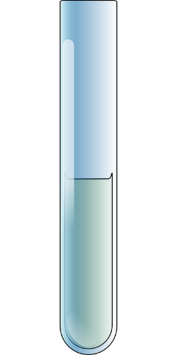
Periodic table – Group 7
A more reactive halogen will also displace a less reactive halogen from solutions of its salts.
E.g. chlorine + potassium bromide → potassium chloride + bromine
Cl₂(g) + 2KBr(aq) → 2KCl(aq) + Br₂(aq)
HIGHER ONLY: These displacement reactions are an example of a redox reaction.
In the example above:
The chlorine is REDUCED as it has GAINIED an electron
The bromine is OXIDISED as it has LOST and electron
Test For Chlorine
The test for chlorine uses litmus paper. When damp litmus paper is put into chlorine gas, the litmus paper is bleached and turns white.

Slide 9
Periodic table – Group 0
THE NOBLE GASES
1
2
3
4
5
6
7
0
H
He
Li
Be
B
C
N
O
F
Ne
Na
Mg
Al
Si
P
S
Cl
Ar
K
Ca
Sc
Ti
V
Cr
Mn
Fe
Co
Ni
Cu
Zn
Ga
Ge
As
Se
Br
Kr
Rb
Sr
Y
Zr
Nb
Mo
Tc
Ru
Rh
Pd
Ag
Cd
In
Sn
Sb
Te
I
Xe
Cs
Ba
La
Hf
Ta
W
Re
Os
Ir
Pt
Au
Hg
Tl
Pb
Bi
Po
At
Rn
Fr
Ra
Ac
Rf
Db
Sg
Bh
Hs
Mt
?
?
?
Elements in Group 0 of the periodic table are called the noble gases. They are unreactive because their atoms have stable arrangements of electrons. The atoms have eight electrons in their outermost shell, apart from helium which has just two but still has a complete outer shell.
The stable electronic structure explains why they exist as single atoms; they have no tendency to react to form molecules.
The boiling points of the noble gases get higher going down the group. For example, helium boils at -269 °C and radon boils at -62°C.

Slide 10

QuestionIT!
Periodic table
Group 1
Group 7
Group 0

Slide 11
Periodic table PART 2 – QuestionIT
What are the elements in Group 0 called?
What are the elements in Group 1 called?
What are the elements in Group 7 called?
What happens to the boiling point of elements in Group 0 as you go down the group?
Why are the elements in Group 0 so unreactive?
Why do all elements in Group 1 react in a similar way to each other?

Slide 12
Periodic table PART 2 – QuestionIT
What happens to the reactivity of the elements as you go down Group 1?
Write a word equation for the reaction between sodium and oxygen.
Why do all the elements in Group 7 react in a similar way to each other?
Halogens are diatomic. What does the word ‘diatomic’ mean?
What happens to the reactivity as you go down Group 7?

Slide 13
Periodic table PART 2 – QuestionIT
What happens to the melting point and boiling point as you go down Group 7?
Write a word equation for the reaction between lithium and chlorine.
Write a balanced chemical equation for the reaction between lithium and chlorine gas.
How do you test for the presence of chlorine gas?

Slide 14

AnswerIT!
Periodic table
Group 1
Group 7
Group 0

Slide 15
Periodic table PART 2 – QuestionIT
What are the elements in Group 0 called?
Noble gases.
What are the elements in Group 1 called?
Alkali metals.
What are the elements in Group 7 called?
Halogens.
What happens to the boiling point of elements in Group 0 as you go down the group?
Increase.
Why are the elements in Group 0 so unreactive?
Full outer shell of electrons.
Why do all elements in Group 1 react in a similar way to each other?
1 electron in outer shell.

Slide 16
Periodic table PART 2 – QuestionIT
What happens to the reactivity of the elements as you go down Group 1?
Increases.
Write a word equation for the reaction between sodium and oxygen.
sodium + oxygen → sodium oxide
Why do all the elements in Group 7 react in a similar way to each other?
7 electrons in outer shell.
Halogens are diatomic. What does the word ‘diatomic’ mean?
There molecules contain 2 atoms.
What happens to the reactivity as you go down Group 7?
Decreases.

Slide 17
Periodic table PART 2 – QuestionIT
What happens to the melting point and boiling point as you go down Group 7?
Increases.
Write a word equation for the reaction between lithium and chlorine.
lithium + chlorine → lithium chloride
Write a balanced chemical equation for the reaction between lithium and chlorine gas.
2Li(s) + Cl₂(g) → 2LiCl(s)
How do you test for the presence of chlorine gas?
Damp litmus paper bleached white.

